Slide 1
Lotz Lab Safety Orientation - Visiting Investigators Professional Scientific Collaborators
The

Slide 2
What you will need to sign – included in email from Connie
1. ‘Orientation Lab Safety Checklist’ – sign and email to molmer@scripps.edu and cc cchoate@scripps.edu
You have the option to receive Tdap & Hepatitis B vaccinations (and/or a titer).
If you chose to not have the HepB vaccination,
you MUST SUBMIT the ‘HBV Declination Form’ –
sign and email to Rachel rachellv@scripps.edu and cc molmer@scripps.edu

Slide 3
Welcome to the Lotz Lab
If you ever have any questions, please do not hesitate to ask someone.
New methods, protocols, and skillsets may be required. If and when you need assistance, we can help connect you with someone that can offer insight and teaching.

Slide 4
Safety Shower, Eye wash, Fire extinguishers
We have a safety shower and eye wash located at the entrance of MB104.
If you need to use the eye wash, please let another lab member know to call EH&S and report this.
Wash your eyes continuously for 15mins.
A fire extinguisher is located within the lab next to the entrance. There are other extinguishers located in the hallway.

Slide 5
Evacuation and Re-grouping
If there is an alarm signifying an evacuation to take place, please exit the building.
Use the exit closest to our lab (south side of our building).
Turn left and walk up the sidewalk to the Flame of Knowledge statue (pictured here).
This is where our lab re-groups and we make sure that everyone is present.

Slide 6
Standards for Lotz Lab Safety
Buttoned-up lab coat worn in the lab space at all times
Close-toed shoes – no flip-flops or sandals. Shoes with holes or mesh do not provide adequate protection from chemical spills or sharps.
Long pants
Eye protection at bench when using hazardous materials or biological materials
Use fume hood when using volatile or hazardous materials. There is one lab snorkel as well. For example: Beta-mercaptoethanol, Trizol, paraformaldehyde, chloroform…
TC room - Change gloves when exiting TC room (BSL2/2+) into lab space.
Viral work needs to be labeled and noted on the incubator door. If centrifuging, you must use aerosol caps.
Keep TC hoods and fume hoods clean and uncluttered.
Biohazard bins – empty when 75% full so that we can tie bags and not have pipettes stick out due to overfilling.
Sharps containers – do not overfill, see label fill-line on container.
Liquid Nitrogen - use lab coat, cryogloves (blue), and face shield. Remember to release gas from each cryovial when removing from liquid nitrogen in order to avoid exploding vials.
Ask for training when you need to use the autoclave for the first time. There are heat resistant gloves in the lab for handles hot materials.
Always label tubes and containers (even for water) so that you can identify the tube’s contents.

Slide 7
Lab postings near MB102 entrance

Slide 8
When an injury or spill occurs: notify lab safety office and/or PI right away. It is highly encouraged to go to Occ. Health with any injury.

Slide 9
Occupational Health Procedures – Required for Our Lab
Tdap vaccination
Hepatitis B titer or HepB vaccination series, or declination form.
Report the injury to the lab and PI, EH&S will be notified and a report will be made.
With an injury, please go to Occupational Health (or Urgent Care after hours) to assess the situation.

Slide 10
Fume hood and Flammables Cabinets
Yellow Flammables Cabinet
Fume Hood and Flammables Cabinet on the bottom left

Slide 11
Chemical Stock Area
We have an inventory of our lab chemicals.
On the top shelf, there are dust masks and N95 masks if needed.
When chemicals containers become empty, please rinse container and deface the lab.
If there is a barcode sticker on the container, please remove this and stick it onto the yellow barcode sheet near the MB102 entrance.

Slide 12
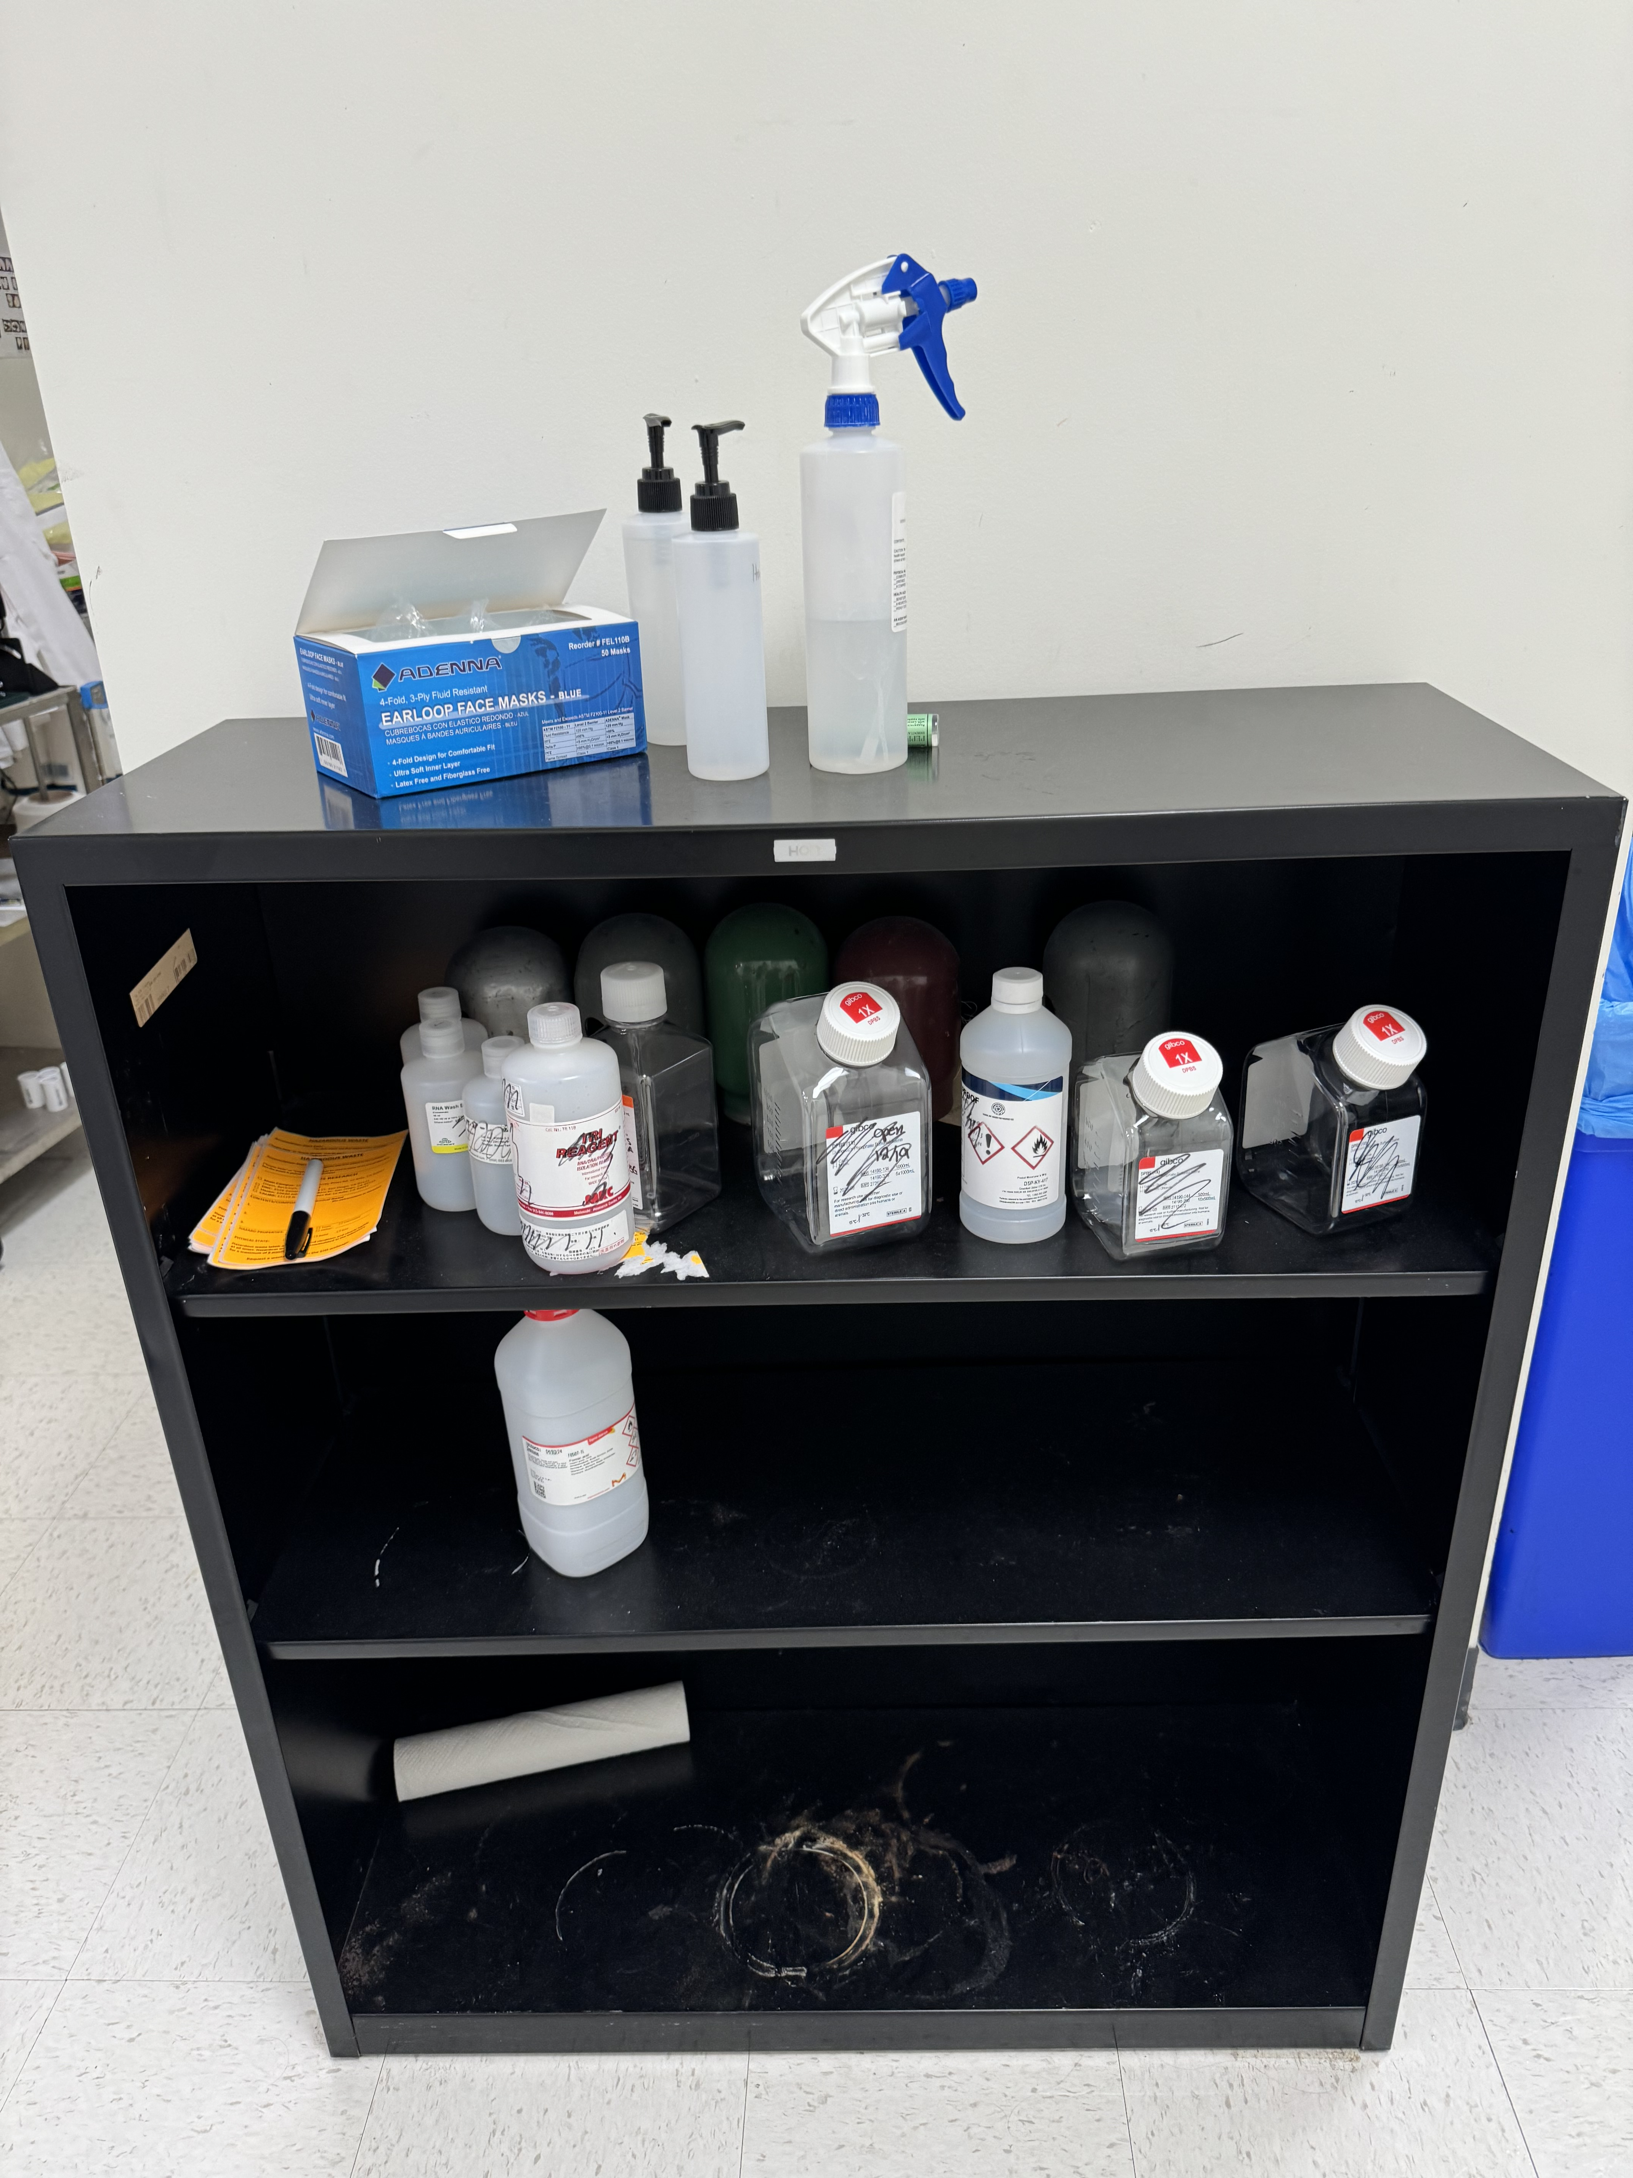
Waste Shelf
Place your full or expired chemicals on the bottom shelf for disposal.
New orange waste labels are located on the top shelf.
You must indicate the start date, Main campus, chemicals, and property of the chemicals that being collected as waste.

Slide 13
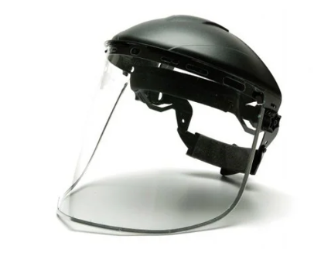
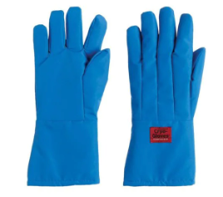
Chemicals and Liquid Nitrogen
There are N95 dust masks available for chemical use, located above chemical stock area.
Liquid Nitrogen use in the lab:
Container with LN should not be kept on floor, to reduce risk of spilling.
Label the container with LN.
Leftover LN can be kept on the benchtop to evaporate.
Wear appropriate PPE – face shield, cryogloves, lab coat

Slide 14
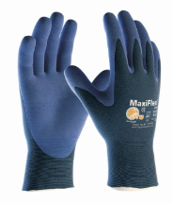
Liquid Nitrogen and Cryovials
LN warms up very fast and vaporizes. If a cryovial tubes has LN inside of it, increasing temperature will cause pressure inside of a cryovial.
When cryovials are taken out of LN and put them on dry ice or at RT, the temperature increases rapidly, so please see the safety precautions below.
These precautions must be taken when working with LN and cryovials:
Make sure to tighten the cryovials all the way shut before snapfreezing your tissues.
- If lids are loose, LN will get into the vial, thus causing a risk of exploding when they are removed from LN.
2. Wear faceshields at all times while working with LN & cryovials that were in LN.
3. Wear the cryogloves when handling LN.
4. Wear the MaxiFlex gloves under the cryogloves. When you remove the cryogloves to handle the cryovials, these MaxiFlex gloves allow dexterity, but are also an added level of protection when handling the cold cryovials and off-gassing them.
5. All cryovials that are in LN, MUST be off-gassed immediately. This means you need to twist the cap slightly open in order to release gas pressure.
Cryogloves
MaxiFlex

Slide 15
TC Room is BSL2 and 2+
There are 3 biosafety cabinets for sterile work.
Do not use hazardous materials in the biosafety cabinets. These are not fume hoods and will recirculate the air inside the hood back into the TC room.

Slide 16
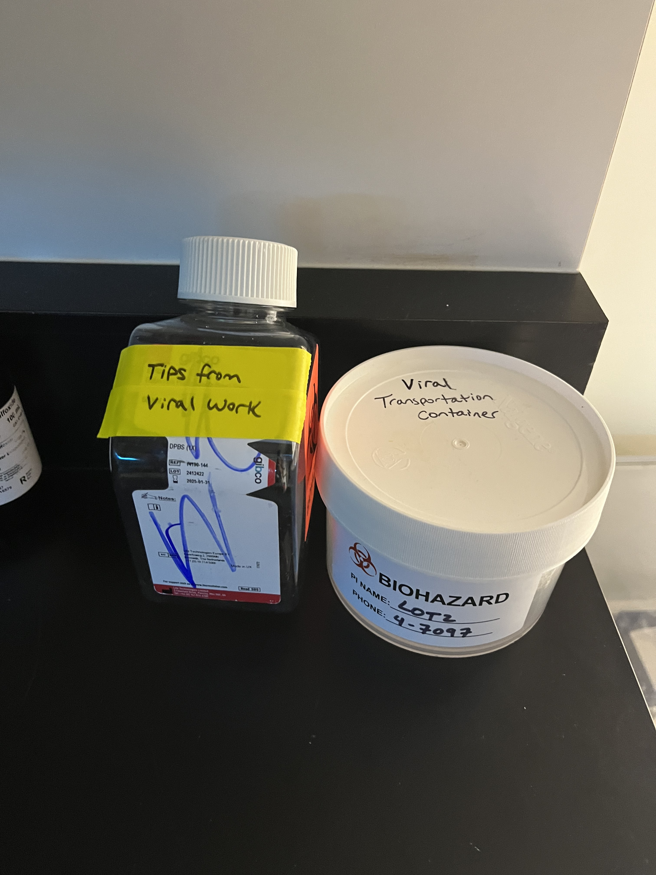
BSL2 and BSL 2+ Work
Tips from viral work must go into closed container. Bleach when full.
Closed transportation container must be used when moving virus to a different lab or vivarium

Slide 17
Viral Work
Use “VIRAL EXPERIMENT IN PROGRESS” form and tape to incubator door when your experiment is ongoing.
Use 10% bleach to decontaminate surfaces.
Use aerosol caps in the centrifuge when spinning down viral solutions.
AV and AAV work on animals: when filling syringes, do not flick the syringe to remove air bubbles. This will reduce the risk of spraying viral solutions.

Slide 18
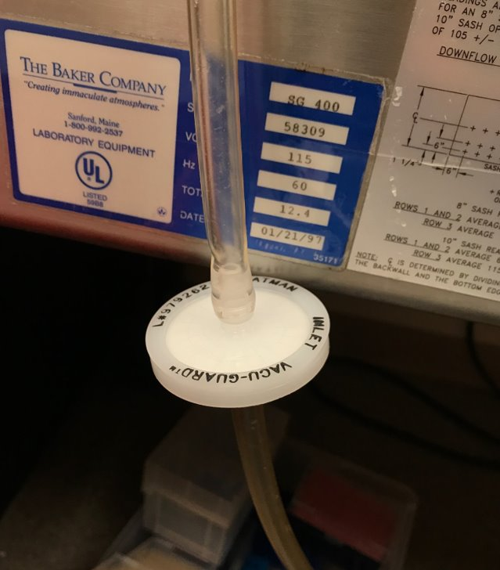
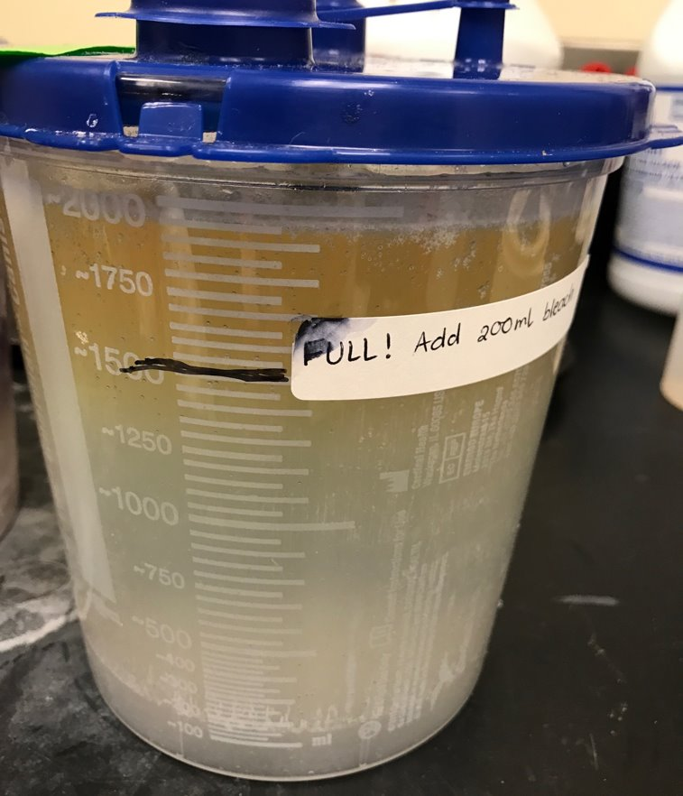
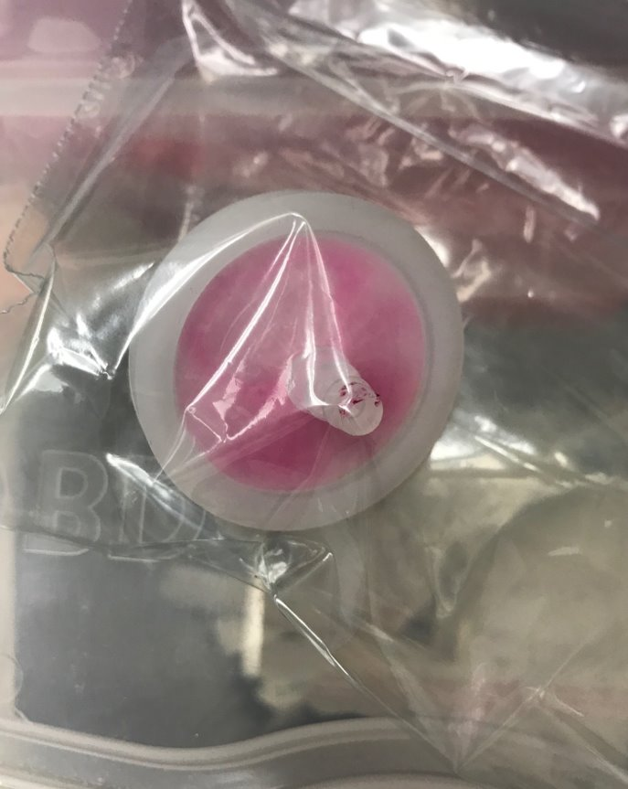
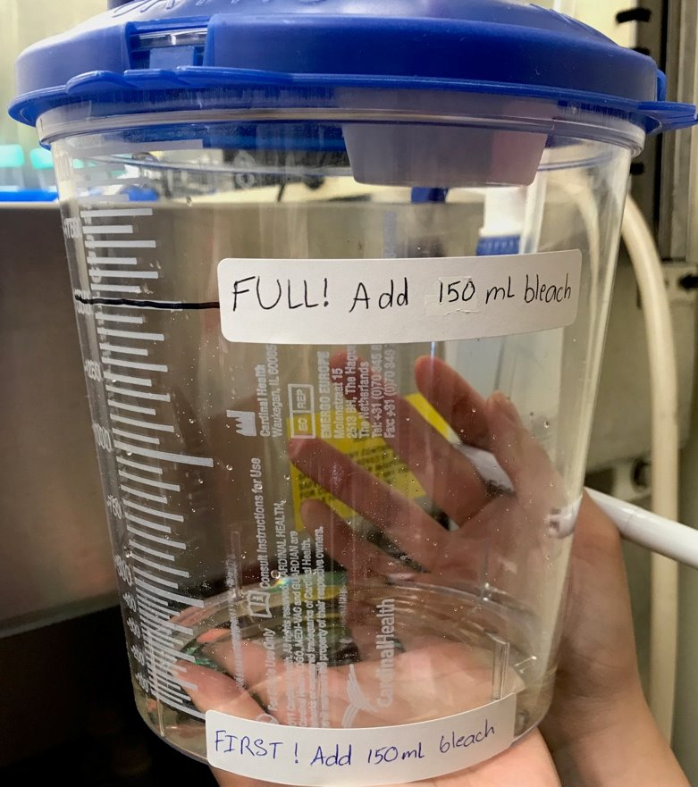
Vacuum Waste Containers
Every vacuum line must have a filter – EH&S Necessity. If this needs to be replaced, please ask Merissa or Kevin for a new one
2000mL is the maximum or else there is overflow and the filters are ruined.

Slide 19
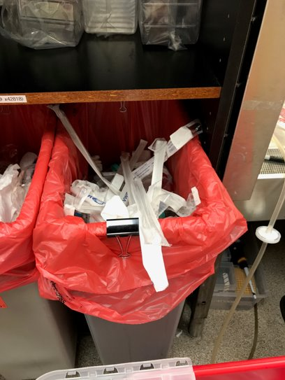
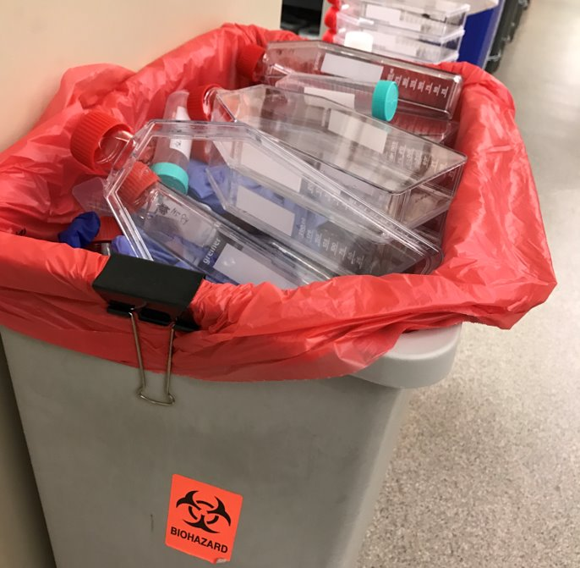
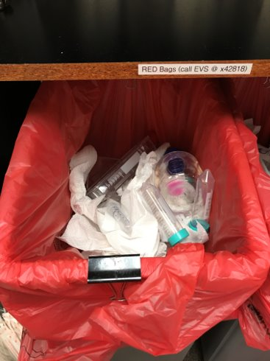
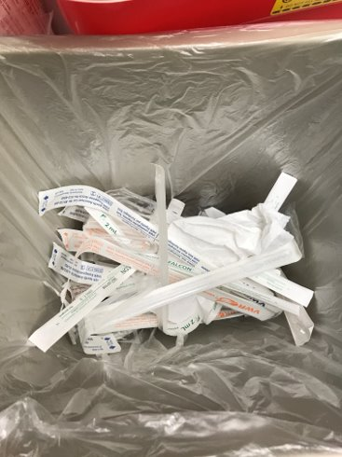
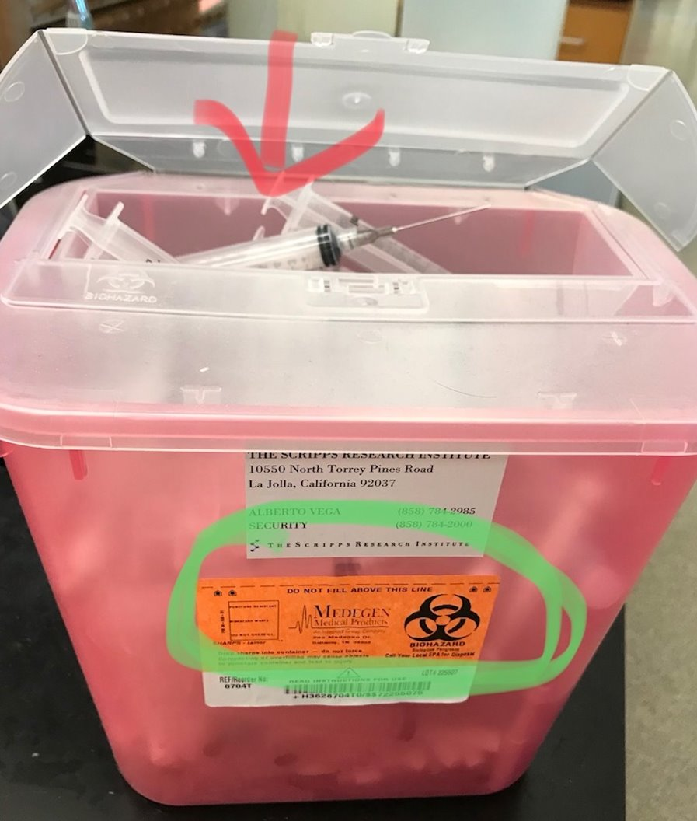
Biohazard and Sharps Containers
X
Violations – Overfilling Containers, Items sticking out
Correct: is below and not sticking out of the container. Correct: non-biohazardous is in the trashcan (or is recycled for media bottles)​
✓

Slide 20
Key points
Follow safety regulations for your own safety and to protect others.
Whenever working with a new reagent, read about the components of the reagent so that you can protect yourself and dispose of the reagent in an environmentally safe way.
Maintain a clean environment (office/desk, all lab areas).
Clean up after you use shared space and equipment.
Re-order shared reagents before they run out.
We need every individual to do their best so that we have a safe and functional lab environment. Focus on your experiments to make safety a priority.
Should you have any questions or concerns about lab safety or conditions in the lab, do not hesitate to speak with Merissa or Martin.
Thanks to each one of you for your contribution.

